Slide 1
INTERNET SEARCH
Searching for Information on the Web

Slide 2
Search
to carefully look for someone or something : to try to find someone or something.
search is the process of looking for something or someone.

Slide 3
Using Search Engines to Find Information on the Web
Search engine is a software system that is designed to search for information on the World Wide Web.
A computer program that is used to look for information on the Internet.
A computer program which finds information on the Internet by looking for words that users have typed
A site on the World Wide Web that uses software to locate key words in other sites.
A type of website that helps a computer user find information on the Internet.
Search engines are useful to find information about anything quickly and easily.

Slide 4
Examples of Search Engines
www.google.com
www.ask.com
www.bing.com
www.msn.com
www.yahoo.com
  https://search.yahoo.com/

Slide 5
Search engine - looks through other web pages for the text the user wants to find.
To use a search engine you must enter at least one keyword into the search box.
An on-screen button must be clicked on to submit the search or pressing Enter key.
Search engine looks for matches between the keyword(s) entered in its database of websites and words.

Slide 6
After a search is submitted search engine results page will appear on screen.
Results page is a list of webpages that contain matches to the keywords that were searched.
A user can click on any of the links to go to one of the websites.
The words you type into the search box are called "keywords."
Search engine retrieves a list of documents containing the specified keywords.
The keywords you use will greatly affect your results.

Slide 7
When Searching for Information on the Web
Identify your concepts (idea)
  E.g. Clinton, Republicans, Budget
List keywords for each concept
  For example:
    Budget Negotiations
    Budget Battle
Specify the logical relationships among your keywords
  Boolean logic allows you to specify the relationships among search terms by using any of three logical operators: AND, OR, NOT.

Slide 8
How do you search for info on the internet?
Using the address bar
Phrase searching
Using Boolean operators
Using the Google Advanced Search Option

Slide 9
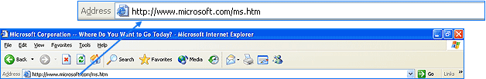
Searching using the address bar
Write Website address(URL) in the address bar.

Slide 10
Phrase searching
Requires all your search terms to appear in exactly the order you enter them.
Enclose the term in double quotations e.g. “instructional design ”

Slide 11
Searching using Boolean Operators
A type of search that allow users to combine keywords with operators such as AND, NOT and OR to produce more relevant results.
You can use Boolean operators to either narrow or broaden search results.
Boolean operators are:
  AND
  OR
  NOT

Slide 12
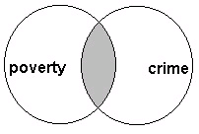
AND operator
AND finds pages containing all your words.
Use AND to narrow your search: all of your search terms will be present in the retrieved records.
The oval in the middle of the Venn diagram below represents the result set for this search.
It is the combination of these two search terms.

Slide 13
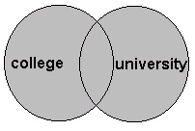
OR operator
OR finds pages containing any of your words
Use OR to broaden your search by connecting two or more synonyms.
The database retrieves all unique records containing one term, the other or both.

Slide 14
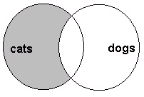
NOT operator
Use NOT to exclude term(s) from your search results.
NOT - excludes any page containing that word (use cautiously!)

Slide 15
Combining Boolean Operators
Boolean Operators can be combined e.g. (Women or jobs) and Malawi.
You can use parenthesis or combine directly.
Helpful when you are not sure of the spelling e.g. (Sarajevo or Sarayevo) and human rights.

Slide 16
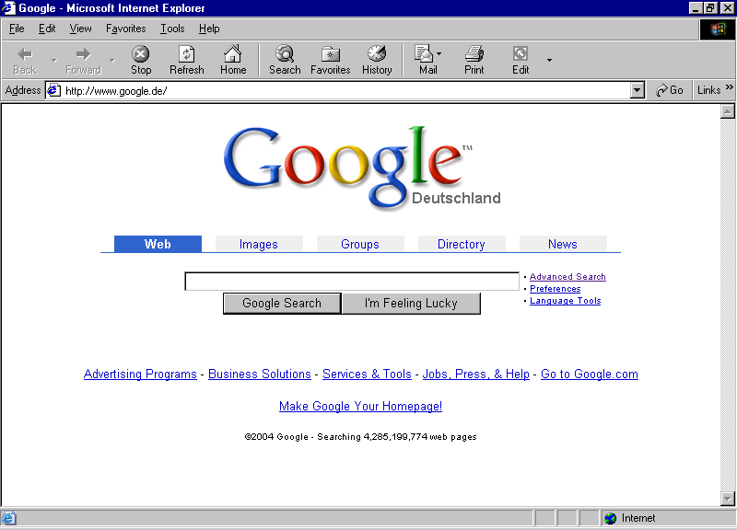
Using Google Advanced Search Option

Slide 17
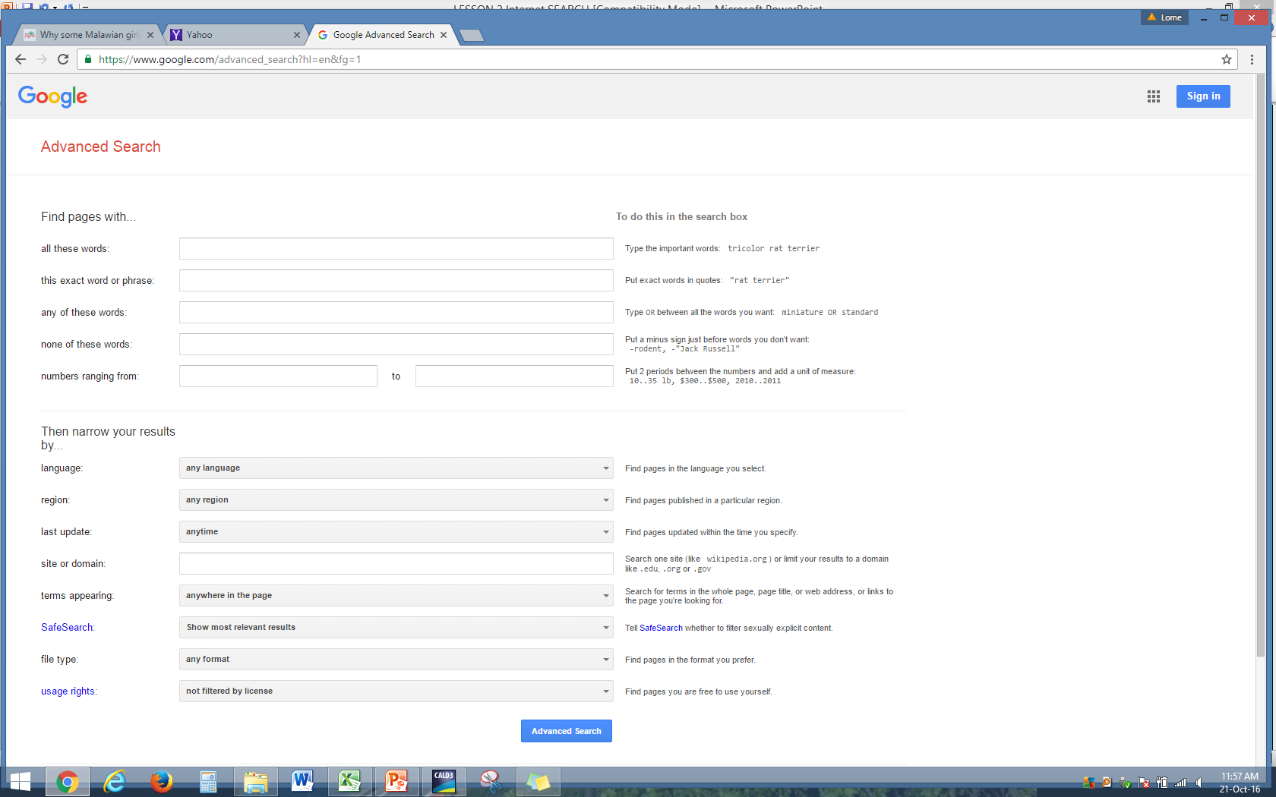
Gives you a number of ways to limit your search

Slide 18
Subject Directory
Definition:
A subject directory is a service that offers a collection of links to Internet resources submitted by site creators or evaluators and organized into subject categories.
A subject directory is an online database of web sites and online information set up by subject and category.
Searches need to be less specific than search engines.
For general, research oriented queries, and when you want to view sites often recommended by experts, use a subject directory

Slide 19
Subject Directory
There are two basic types of directories:
  academic and
  professional directories.
Directories are often created and maintained by subject experts to support the needs of researchers.
INFOMINE (http://infomine.ucr.edu/), from University of California - an academic subject directory.

Slide 20
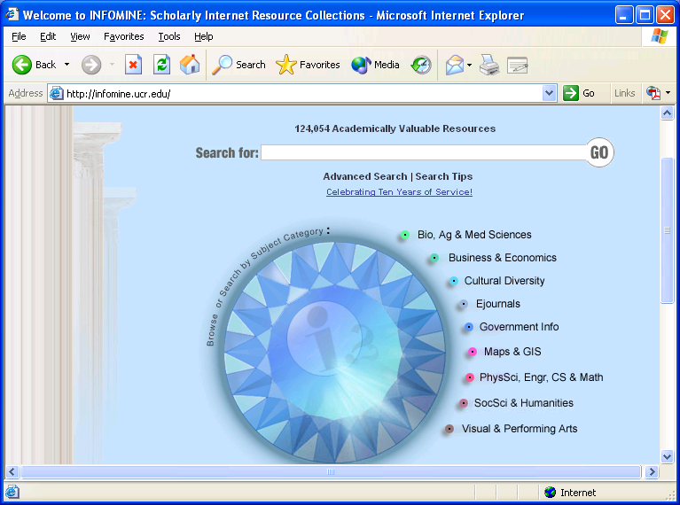

Slide 21
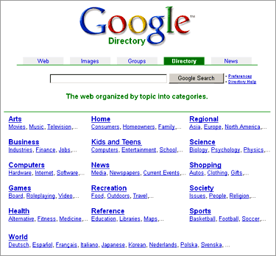

Slide 22
CRITICAL EVALUATION
Why Evaluate What You Find on the Web?
Anyone can put up a Web page about anything for money in minutes.
Many web pages are not kept up-to-date.
No quality control.

